Slide 1

មជ្ឈមណ្ឌលកូរ៉េ សហ្វវែរ អេច អ ឌី
Korea Software HRD Center
Java Presentation Materials
ឣ្នកប្រឹក្សាយោបល់: បណ្ឌិត​​ គីម​ ថេខ្យុង
ឣ្នកណែនំា: លោក រ៉ាត ភារុន
លោក អាង តិចជន
លោក អាំង តឹកជុន
កញ្ញា អៀត ម៉ានិត
www.kshrd.com.kh

Slide 2
ថ្នាក់ បាត់ដំបង
ក្រុមទី ៤
ប្រធានបទ៖ Thread
សមាជិក
លោក ជា ភក្តី
លោក ហ៊ីម​ ខេមរា
លោក ហេង ម៉េងតាំង
កញ្ញា សំអុល​ សំអន
លោក ឈៀង សុវណ្ណវាសនា

Slide 3
មាតិកា
Thread
Program, process, thread concept
Two ways of implement thread (Thread/Runnable)
Commonly used method in Thread class (sleep, join, wait, notify,..)
Synchronization

Slide 4
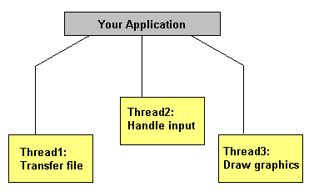
I. Thread
Thread ជាប្រភេទ light-weight ដែលជាផ្នែកមួយតូចបំផុតនៃដំនើរការដែលអាច run ស្របពេលជាមួយ និងដំនើរការផ្នែកដ៏ទៃទៀតនៅក្នុងពេលជាមួយគ្នាបាន។

Slide 5
II. Program, process, thread concept
Program:
➢​ គឹជា Executable File ដែលផ្ទុកនូវបណ្តុំ Instructions ដែលគេសរសេររួចជាស្រេច សំរាប់អោយវា Perform a specific job នៅក្នុង computer ។
Ex: chrome.exe គឺជា File execchrome.exe គឺជា File execute ដែលផ្ទុកនូវ Instruction សំរាប់ view web page ។ Instruction ទាំងអស់ផ្ទុកនៅក្នុង​ Primary memory and Execute on CPU​​។

Slide 6
II. Program, process, thread concept
Process:
➢​ គឺជាដំនើរការ Executing instance of a program
➢ Process មួយអាចមាន Thread ច្រើន
➢ ជា Heavyweight tasks
➢ មិនមានការ share memory
➢ Multi Tasking
Ex: ក្នុង​ Window ( OS ) យើងអាច run process ជាច្រើន Notepad, Media Player, Browser…..

Slide 7
II. Program, process, thread concept
Thread:
➢​ Thread គឺជាដំណើរការ executable unit តូចមួយនៅក្នុង​Process 1.
➢ Thread is Lightweight process(Share memory of the process)
➢ Every Process តែងតែមាន​យ៉ាងហោចណាស់ Thread 1 or Multi Thread
Ex: នៅក្នុង​ Notepad Program, One thread ចាំទទួល User input and another thread will be printing document
➢ All Thread In Java Created and Control in java.lang.Thread class.
​

Slide 8
II. Program, process, thread concept
​
Process | Thread
Processes are heavy weight operations. | Threads are light weight operations.
Every process has its own memory space. | Threads use the memory of the process they belong to.
Inter process communication is slow as processes have different memory address. | Inter thread communication is fast as threads of the same process share the same memory address of the process they belong to.
Context switching between the process is more expensive. | Context switching between threads of the same process is less expensive.
Processes don’t share the memory with other processes. | Threads share the memory with other threads of the same process.

Slide 9
II. Program, process, thread concept
Thread​ Life Cycle:
➢​ New: បង្កើត Instance នៃ Thread Class, Thread not alive yet.
➢ Runnable: នៅពេល method start() ត្រូវបាន call, thread become runnable
➢ Running: Thread schedule select thread សំរាប់ Running , ហើយ​ method start() ចាប់ ផ្តើមទៅហៅ Method run()
➢ waiting: ជាពេលដែល thread ដែលមិនមានសិទ្ធិក្នុង​ការ Run, ប៉ុន្តែ Thread still alive , ដំណាក់កាលនេះវា calling method wait()
➢ Terminated: នៅពេល method run() complete
​

Slide 10
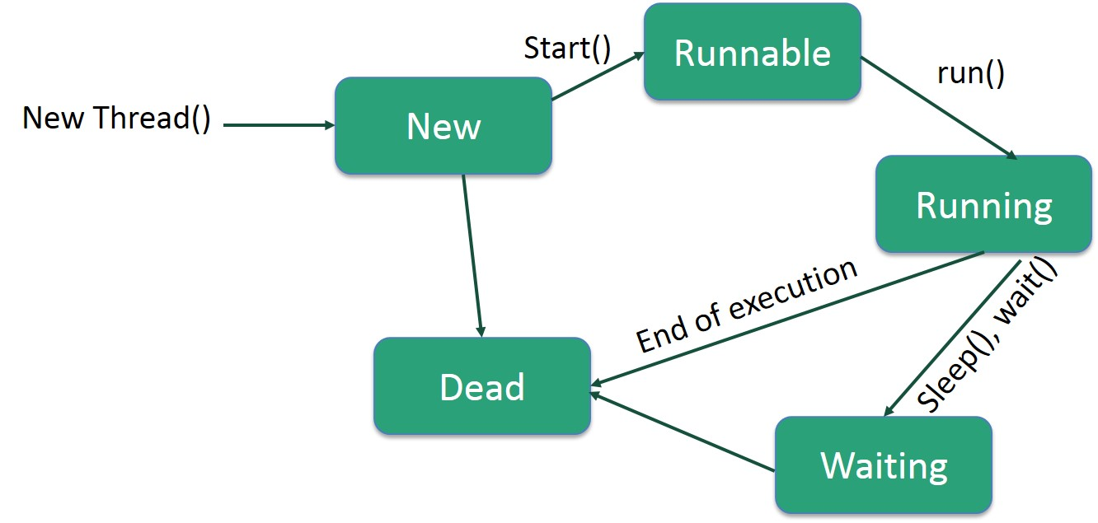
II. Program, process, thread concept
​

Slide 11
III. Two ways of implement thread
មានវិធីសាស្ត្រពីរសំរាប់ implement Thread៖
Extending Thread class
class MultithreadingDemo extends Thread{
public void run(){
System.out.println("My thread is in running state.");
}
public static void main(String args[]){
MultithreadingDemo obj=new MultithreadingDemo();
obj.start();
}
}

Slide 12
III. Two ways of implement thread
មានវិធីសាស្ត្រពីរសំរាប់ implement Thread៖
Implementing Runnable interface
class MultithreadingDemo implements Runnable{
public void run(){
System.out.println("My thread is in running state.");
}
public static void main(String args[]){
MultithreadingDemo obj=new MultithreadingDemo();
Thread tobj =new Thread(obj);
tobj.start();
}
}

Slide 13
IV. Commonly used method in thread class
getName(): it is used for obtaining a thread’s name
getPriority(): obtain a thread’s priority
isAlive(): Determine if a thread is still running
join(): wait for a thread to dominate
run(): entry point for the thread
sleep(): suspend a thread for a period of time
Start(): start a thread by calling its run() method

Slide 14
IV. Commonly used method in thread class
Join() ប្រើសម្រាប់ wait រហូតដល់ thread មួយដំណើរការចប់ទើបអោយthreadមួយទៀតដំណើរការ។
public class JoinDemo extends Thread{
public void run(){
for (int i=0 ; i<5 ; i++) {
try {
Thread.sleep(500);
} catch (InterruptedException e) {
e.printStackTrace();
}
System.out.println(i);
}
}
public static void main(String[] args) throws InterruptedException {
JoinDemo j1=new JoinDemo();
JoinDemo j2=new JoinDemo();
JoinDemo j3=new JoinDemo();
j1.start();
//use for wait thread utill to died
j1.join();
j2.start();
j3.start();
}
}
Output
0
1
2
3
4
0
0
1
1
2
2
3
3
4
4

Slide 15
IV. Commonly used method in thread class
Sleep ប្រើសម្រាប់បង្អាក់ដំណើរការThread ។
public class SleepDemo extends Thread {
public void run(){
for(int i=0 ; i<5 ; i++){
try {
Thread.sleep(5000);
} catch (InterruptedException e) {
e.printStackTrace();
}
System.out.println(i);
}
}
public static void main(String[] args) {
SleepDemo sl1=new SleepDemo();
SleepDemo sl2=new SleepDemo();
sl1.start();
sl2.start();
}
}
Output
0
0
1
1
2
2
3
3

Slide 16
IV. Commonly used method in thread class
Wait() ប្រើសម្រាប់រង់ចាំរហូតដល់thread មួយទៀតបោះនូវnotify() or notifyAll()។
public class ThreadWait {
public static void main(String[] args){
ThreadB b = new ThreadB();//Create Instance for seconde class
b.start();//Launch thread
synchronized(b){
try{
System.out.println("Waiting for b to complete...");
b.wait();//WAIT until the finish thread for class B finish
}catch(InterruptedException e){
e.printStackTrace();
}
System.out.println("Total is: " + b.total);
}
}
}
class ThreadB extends Thread{
int total;
@Override
public void run(){
synchronized(this){
for(int i=0; i<100 ; i++){
total += i;
}
notify();
/*Notify the class which wait until
my finish and tell that I'm finish*/
}
}
}
Output
Waiting for b to complete...
Total is: 4950

Slide 17
IV. Commonly used method in thread class
Priority() សម្រាប់កំណត់អាទិភាពអោយThread ដែលមានតំលៃពី ១ ដល់ ១០ ។
getName() សម្រាប់ចាប់យកឈ្មោះរបស់Thread ដែលកំពុងបានដំណើរ ។
public void run(){
System.out.println("running thread name is:"+Thread.currentThread().getName());
System.out.println("running thread priority is:"+Thread.currentThread().getPriority());
}
public static void main(String args[]){
PriorityDemo thread1=new PriorityDemo();
PriorityDemo thread2=new PriorityDemo();
thread1.setPriority(Thread.MIN_PRIORITY);
thread2.setPriority(Thread.MAX_PRIORITY);
thread1.start();
thread2.start();
}
Output:
running thread name is:Thread-0
running thread name is:Thread-1
running thread priority is:1
running thread priority is:10

Slide 18
V. Synchronization
Synchronized ប្រើសម្រាប់កំនត់អោយThread មួយដំណើរការចប់ទើបអោយThreadមួយទៀតដំណើរការ ។
class Table{
synchronized void printTable(int n){//synchronized method
for(int i=1;i<=5;i++){
System.out.println(n*i);
try{
Thread.sleep(400);
}catch(Exception e){
System.out.println(e);
}
}
}
}
class MyThread1 extends Thread{
Table t;
MyThread1(Table t){
this.t=t;
}
public void run(){
t.printTable(5);
}
}
class MyThread2 extends Thread{
Table t;
MyThread2(Table t){
this.t=t;
}
public void run(){
t.printTable(100);
}
}

Slide 19
V. Synchronization(ត)
public class SynchronizedDemo{
public static void main(String args[]){
Table obj = new Table();//only one object
MyThread1 t1=new MyThread1(obj);
MyThread2 t2=new MyThread2(obj);
t1.start();
t2.start();
}
}
Output:
100
200
300
400
500
5
10
15
20
25

Slide 20
10. ប្រភពឯកសារ
http://www.javatpoint.com
https://docs.oracle.com
http://www.tutorialspoint.com
http://stackoverflow.com
http://www.tutorialspoint.com/java/java_thread_synchronization.htm
https://docs.oracle.com/javase/tutorial/essential/concurrency/sync.html
https://www.techopedia.com/definition/24349/thread-synchronization
http://tutorials.jenkov.com/java-concurrency/synchronized.html

Slide 21

សំនួរ ចម្លើយ!

Slide 22
សូមអរគុណ!!!

